Slide 1

Data Exploration & Visualisation
Lecture 2
LSM3257
AY22/23; Sem 2 | Ian Z.W. Chan

Slide 2
Summary (Learning Objectives)
Importance of data exploration
- The Golden Rule
- Loading datasets into R
3 steps in data exploration:
1) Understand your variables
- Variable types (R storage): num, int, chr, logi, Factor
2) Correct mistakes, Look for outliers, Look for the unexpected
3) Look for patterns (data visualisation)
- Variable types (data types): categorical, continuous
- One variables
- Two variables
- Three variables
- Survival curves
Plotting aesthetics

Slide 3
Importance of data exploration

Slide 4
Good data exploration builds a strong foundation for our analysis
1) Understand the dataset
- Know what variables are in it
- Know how the variables are coded
2a) Look for mistakes (e.g. typos, wrong files) and missing values
2b) Look for outliers
- Decide what to do: remove, replace, ignore?
3) Look for obvious patterns or correlations
- Go back to the biological meaning of the data
- Helps to avoid “data mining” in later analysis

Slide 5
Understanding datasets
Golden Rule: Each column is one variable; Each row is one observation
Which is correct?
Dataset A
Dataset B
Site | Colour | Value | Status
L | Blue | 177 | 4
M | Red | 185 | 3
V | Red | 192 | 5
J | Nil | 190 | 1
H | Nil | 183 | 2
W | Purple | 182 | 4
Y | Green | 124 | 5
Colour | Red | Blue | Green | Purple
 | M V | L | Y | W
Value |  |  | Status
L | 177 |  | 1 | J
M | 185 |  | 2 | H
V | 192 |  | 3 | M
J | 190 |  | 4 | L W
H | 183 |  | 5 | V Y
W | 182
Y | 124

Slide 6
Loading datasets in R
How do I get datasets in R?
1) Import them from a file (covered last week)
“Data.txt” will need … read.table("Data.txt",header=T)
“Data.csv” will need … read.csv("Data.csv")
“Data.xlsx” will need … read_excel("Data.xlsx") #after installing <readxl>
2) Pre-loaded datasets
3) Manually create them using data.frame() (we never use this)
Answer
Answer
Answer

Slide 7
Pre-loaded datasets
Datasets built into Base R
data(package="datasets") #see what datasets are in-built in R
Datasets included in packages, e.g. “nlme”
#Install the package
install.packages("nlme")
library(nlme)
#Check what datasets are in the package
data(package="nlme") #one of them is <Alfalfa>
#Load the dataset from the package (not always necessary, but good practice)
data(Alfalfa)
#To see the first few rows of the Alfalfa dataset
head(Alfalfa)

Slide 8
Understand your variables

Slide 9
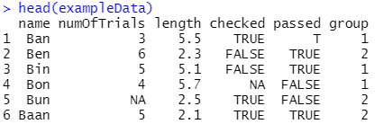

First look
Dataset of 6 crabs who were put through an obstacle course.
Check the top/bottom few rows
head(exampleData)
tail(exampleData)
Check rows and columns
dim(exampleData)
nrow(exampleData)
ncol(exampleData)
colnames(exampleData) #To check the names, can be useful with large datasets
rownames(exampleData)
<numOfTrials>: number of times they went through the course
<Length>: of carapace
<checked>: for infection
<passed>: whether completed the course
<group>: treatment group
No. of rows (no. of observations)
No. of columns (no. of variables)

Slide 10
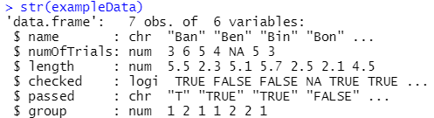
A deeper look
To get information on each variable in the dataset:
str(exampleData)
Important Variable Types (for storage in R)
“num”: Numeric – numbers in general
“int”: Integer – whole numbers only
“chr”: Character – a string of text as data
“factor”: special type of string for categorical (usually explanatory) variables
“logi”: Logical – TRUE (T or 1) and FALSE (F or 0) only
Note: 2 more variable types (“complex” and “raw”) are not discussed here, unlikely you will need them.

Slide 11
A deeper look
<name> is chr because of the “ ” (so if you write “1.2” or “T”, it will also become char type)
data.frame type object
7 rows, 6 columns
All numbers (with or without decimals) stored as num by default
<checked> (T or F) was detected as logi and stored as TRUE or FALSE
This tells you what type each variable is stored as
This is the list of variables that are in the dataframe

Slide 12
POP QUIZ!!
(NOT graded, don’t worry)
Go to pollev.com/izwc
Can you find the mistakes in this dataset?

Slide 13
Can you find the mistakes in the dataset?
NA = “Not Available” (missing values) = bad!
Could be int type (not a big difference)
<passed> was supposed to be logi but was detected as chr because the first observation was stored as “T”
Needs to be logi type so that this is recognised as TRUE and FALSE
Probably better to be factor type because it represents two different groups

Slide 14
Correct mistakes, Look for outliers and Look for the unexpected

Slide 15
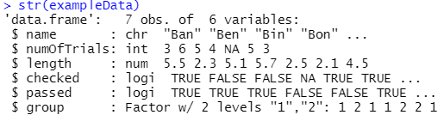
Changing variable types
Commands for coercing variables to different types
as.numeric()
as.integer()
as.character()
as.factor()
as.logical()
Changing <numOfTrials> to int type (not really a mistake):
exampleData$numOfTrials=as.integer(exampleData$numOfTrials)
Changing <passed> to logi type:
exampleData$passed=as.logical(exampleData$passed)
Changing <group> to factor type:
exampleData$group=as.factor(exampleData$group)
Check by calling str() again:
str(exampleData)
My general advice is to change all categorical explanatory variables to factor type (we’ll see why later)
Changed to logi
Changed to Factor: see that is lists how many levels there are—this is useful to us
Changed to int
Before
After

Slide 16
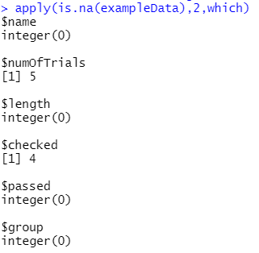
Dealing with NAs (missing values)
Quick search for NAs:
apply(is.na(exampleData),2,which)
What to do when you have NAs? This is a difficult question!
- Do nothing and keep everything: this won’t work because NAs tend to cause errors
- Safest course of action: remove the whole row but this costs you a lot of data
- Somewhere in the middle: remove observations that are NAs when that variable is being analysed but not otherwise
There is a choice!: Data analysis is an art form
Variable name
Row number of observation that is NA
Important errors to find and solve
NA: missing value. Use is.na()
NaN: not a number, e.g. 0/0 in numeric vectors. Use is.nan()
Inf: infinite, e.g. 1/0. Use is.infinite()
No missing values

Slide 17
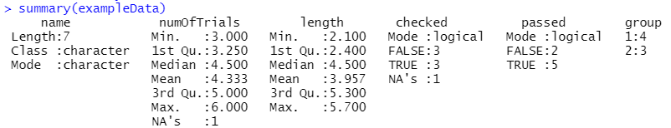
Looking for outliers
Using summary tables:
summary(exampleData) #produces a quick summary of each variable
Shows NAs (many ways to skin a cat)
Is the Min or Max very far out?
Number in each category: outliers don’t apply to this type of variable

Slide 18
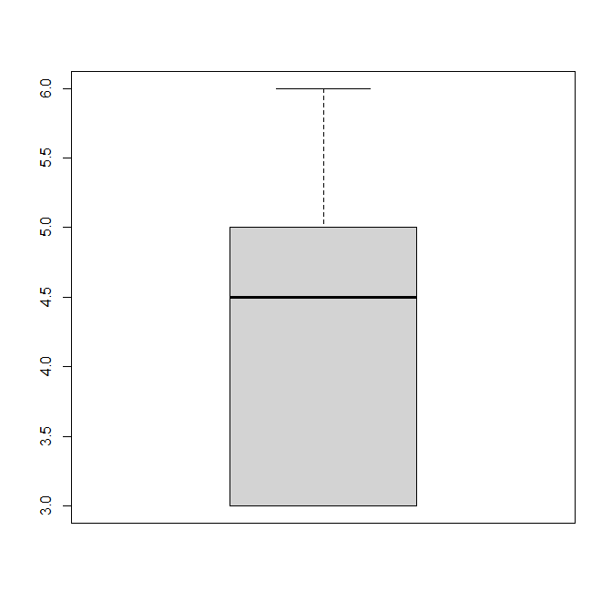
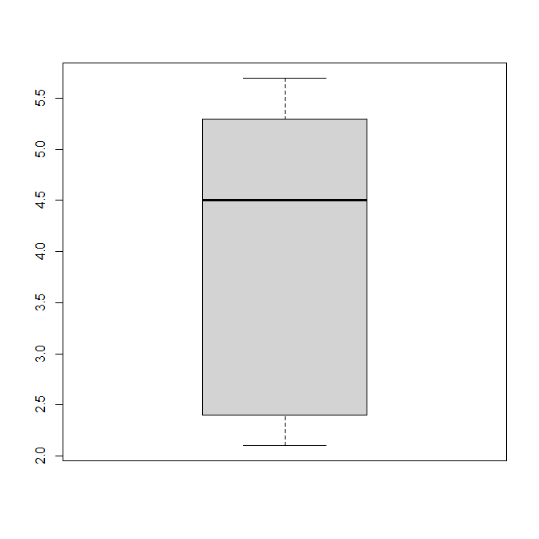
Looking for outliers
This is the function to plot boxplots in basic R
Visually using boxplots:
boxplot(exampleData$numOfTrials)
boxplot(exampleData$length)
Outlier: any point which is either > Q3 + 1.5*IQR or < Q1 – 1.5*IQR
This is a VECTOR of NUMBERS
exampleData$numOfTrials
exampleData$Length
Max
Q3
Median
IQR
Note: when there are potential outliers, the whiskers plot the biggest and smallest non-outliers instead of the maximum and minimum values.
Q1
Min

Slide 19
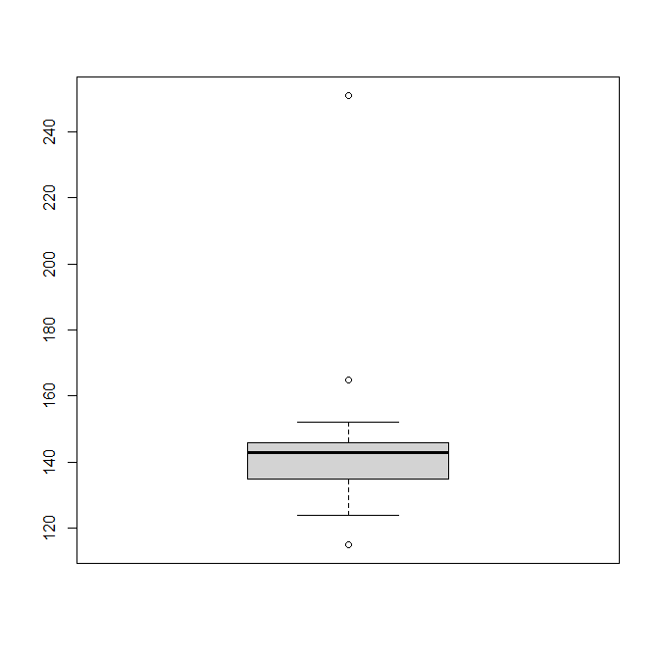


Looking for outliers
What to do with outliers?: It depends! We decide whether or not to remove the outliers based on (1) whether or not they represent legitimate data (some outliers are legitimate, some not), and (2) how and how much they affect the analysis/model.
Another dataset:
outlierExample=c(124,143,145,165,135,136,127,152,146,146,135,115,251)
boxplot(outlierExample)
Based on the values of the whiskers, you might try to identify the outliers manually:
which(outlierExample<120)
which(outlierExample>160)
Or you can use the formula to automatically calculate the whiskers (same result as above):
which(outlierExample<quantile(outlierExample,0.25)-1.5*IQR(outlierExample))
which(outlierExample>quantile(outlierExample,0.75)+1.5*IQR(outlierExample))
outlierExample
Potential outliers
Choose these values based on the whiskers in the boxplot
Biggest non-outlier
Smallest non-outlier

Slide 20
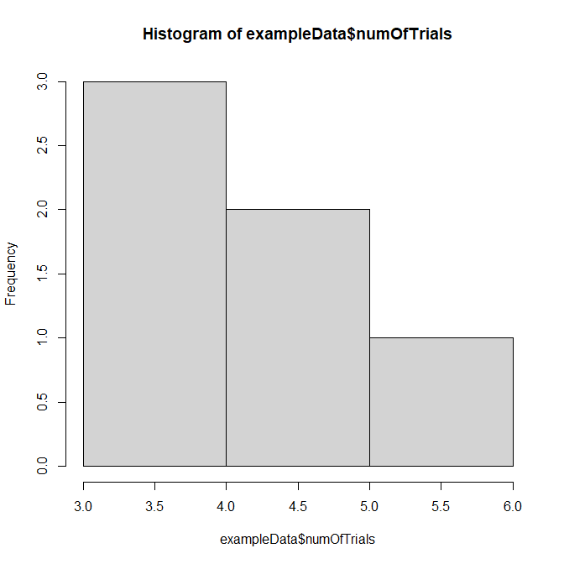
Looking for the unexpected
Requires some prior knowledge/expectations of the data that you collected
- Must always make sure that these are reasonable
Example 1: you expect there to be more crabs with more trials and fewer crabs with less trials
hist(exampleData$numOfTrials) #Plot counts of each category in a histogram
Is this decreasing trend expected?

Slide 21

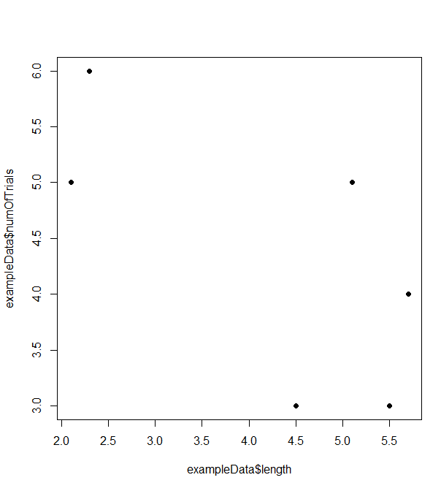
Looking for the unexpected
Example 2: you expect there to be roughly equal number of crabs who passed vs. failed the course
table(exampleData$passed) #List the number of observations in each category
Example 3: I expect two variables to increase together
plot(exampleData$numOfTrials~exampleData$length)
plot(exampleData$length,exampleData$numOfTrials)
This is not equal. Can you trust the data?
This is clearly not increasing together! Can I trust my data?
Also, Why are there no values in the middle? Are there missing datapoints? Sus!
Note the difference in the syntax above: “y~x” but “x,y”. They both produce the same plot, you can choose which way you prefer.
Note 2: by convention, the x-variable predicts (i.e. affects, influences) the y-variable.
Note 3: Verbally, we usually say “plot the <y-variable> against the <x-variable>”.

Slide 22
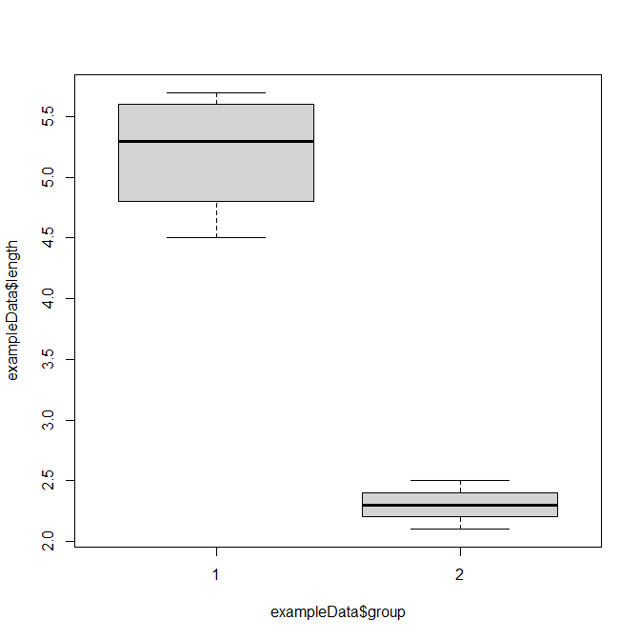
Looking for the unexpected
Example 4: I expect data the <length> of <group> 1 to be much greater than the <length> of <group> 2
boxplot(exampleData$length~exampleData$group)
Question: How did we know which plot to use to look for these expected or unexpected patterns?
Answer: Variable types! (in terms of data type, NOT storage in R)
Separated by this tilde
Plot this data, grouped by this data (the grouping variable)
This is indeed what I see… <group> 1 has much greater <length> than <group> 2. Great!

Slide 23
Before we start…
ggplot2 and exporting figures from R Studio

Slide 24
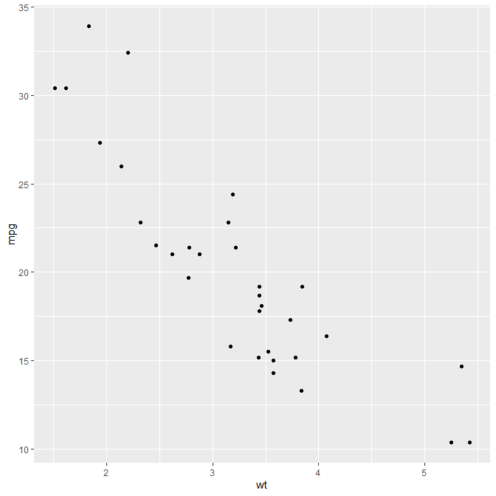
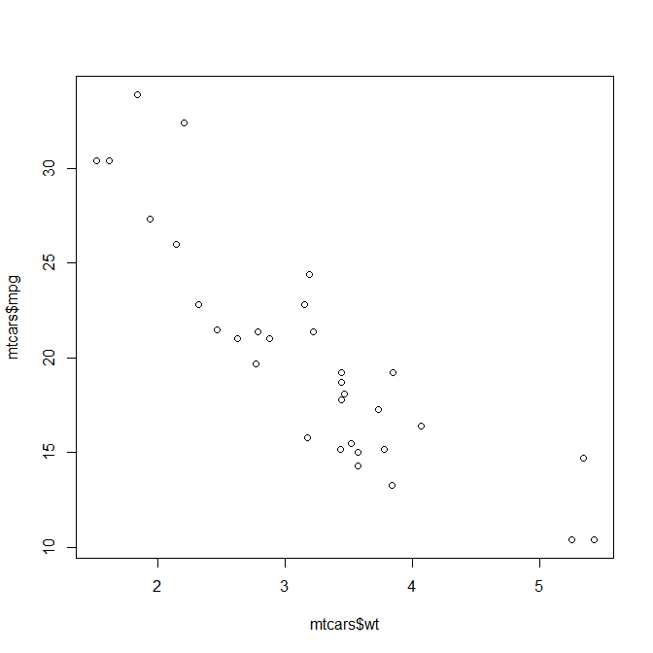

Before we start!: basic R vs. ggplot2
Basic R can produce plots but there’s a package called ggplot2 that is widely used
- Both can do similar things
- Basic R is shorter to code
- ggplot2 looks better by default and can produce complex graphs more readily (so I focus on ggplot2)
My take…
- If you want to just take a quick look at something (Looking for the unexpected): Basic R
- If you’re going to use the output directly from R in your report/publication: ggplot2
- If you’re going to modify this output in another program first (some researchers do this), e.g. with Adobe Illustrator, Photoshop, Powerpoint: Basic R
Whichever you choose, DO NOT use default plots from Excel
ggplot2 default
Basic R default

Slide 25
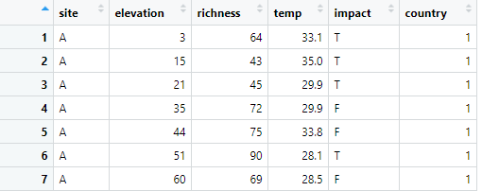
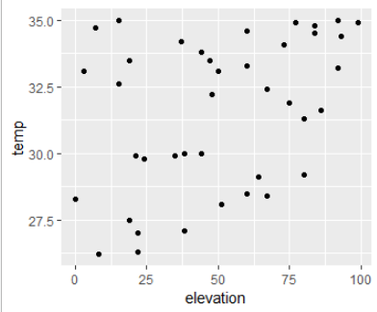
Basics of ggplot2
<data1>
Installing ggplot2 and loading the dataset:
install.packages("ggplot2")
library(ggplot2)
data1=read_excel("protectedAreas.xlsx") #make sure “readxl” is loaded
Typical code to plot a figure:
ggplot(data1, aes(x=elevation, y=temp)) + geom_point()
Some like to add line breaks to make it easier to see:
ggplot(data1, aes(x=elevation, y=temp)) +
geom_point()
Some like to store the “core figure” in an object and then add layers to it:
plotEx = ggplot(data1, aes(x=elevation, y=temp)) #this is the “core figure”
plotEx + geom_point() #this plots the
Dataset to be used
Specify the data for the X and Y axes
Specify the type of figure, this is a scatterplot
Can split lines but must end with a “+” if it’s not the last line

Slide 26
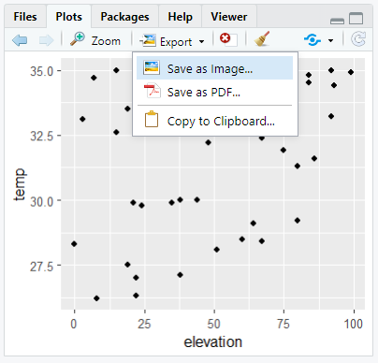
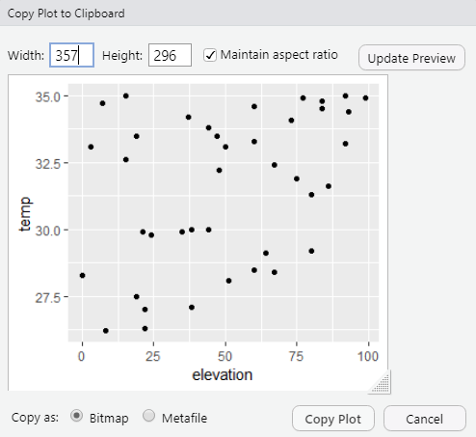
How to get a plot out from R Studio
Method 1: Print entire screen and crop.
Method 2: With OneNote, press (see below) and select the area of the screen to copy (a screen clipping).
- In Windows: [Windows Key][Shift][S]
- In Mac: [Cmd][Ctrl][Shift][4]
Method 3: In the Explorer window, when a plot appears…
- Click Export>Choose the option you want
- For a report/paper: choose Save as image or PDF for higher quality
- For our assignments: choose Copy to Clipboard, change the size and click Copy Plot. Then you can easily paste the plot in Word

Slide 27
Look for patterns
Data visualisation

Slide 28
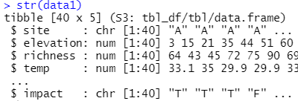
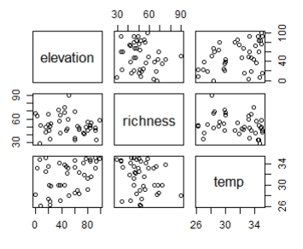
Quick overview of entire dataset
Debugging Time!
Can you spot the error in this slide?
Paris plot (plot every numeric variable against every numeric variable):
pairs(data1) #does not work because there are non-numeric variables
str(data1) #to choose only the numeric variables
pairs(data1[2:4,]) #this is the basic R version
Maybe a weak pattern between <elevation> on x-axis and <temp> on y-axis but it is not clear
Notes:
“data1[2:4,])” should be “data1[,2:4])”

Slide 29
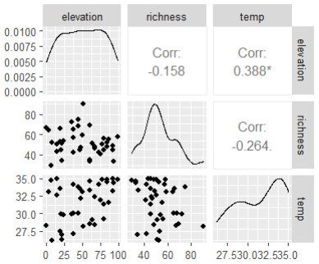
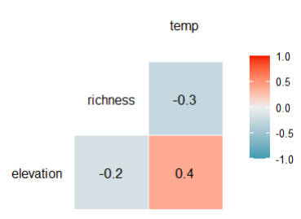
Quick overview of entire dataset
Looks much more sophisticated than the basic R version in the previous slide
Calculating correlations between all pairs of numeric variables:
require(GGally) #install this package first
ggpairs(data1[,2:4]) #this is the ggplot version
corrData = data1[,2:4]
ggcorr(corrData, palette = "RdBu", label = TRUE) #this plots the correlation plot below
R² value: looks like there is some correlation between <elevation> and <temp> (which makes sense) but it is a positive correlation (which is a bit strange).

Slide 30
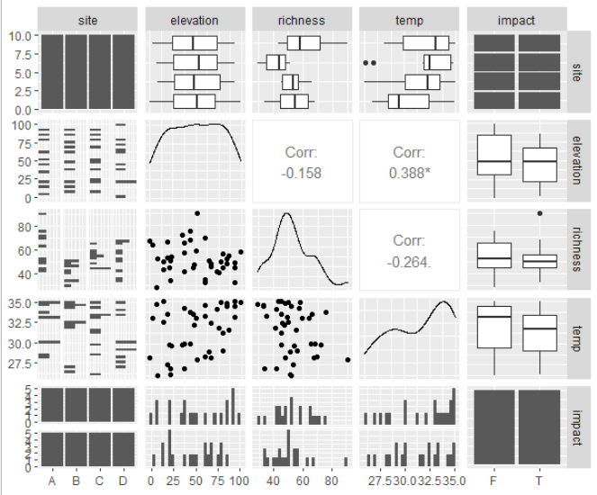
Quick overview of entire dataset
GGally can do a pairs plot for all variable types (not just numeric):
ggpairs(data1)
There are two very important lessons we can learn from this plot!
1) Different plots for different variables types (see left)
2) The plot that is used depends on the variable/ combination of variables being plotted
<site> is a Categorical variable: it’s possible values are discrete—A, B, C and D
<elevation> is a Continuous variable: there are infinite possible values between any two values

Slide 31
How to decide what type of plot to do?
First question: What type of variable(s) are you plotting?
Grey area
Counts
Categorial variables
Variables with a finite number of values/groups
Examples:
- Colour categories
- Biological sex
- True or False
- Site
Continuous variables
Variables with an infinite number of values between any two values
Examples:
- Length/Width/Area/Height/Weight
- Temperature
- Diversity indices
Continuous to Categorical?: sometimes it might be useful to put a continuous variable into bins to convert it to a categorical variable, e.g. ages into age categories. This depends on the study.
Counts: Few unique and small numbers could be categorical; but many large (not close to zero) numbers could be continuous (more on this in future lectures).

Slide 32
How to decide what type of plot to do?
Note: the variable on the x-axis explains/predicts/affects the variable on the y-axis. More on this in the next lecture.
Second question: How many variables are you plotting?
1) One variable (i.e. x-axis only)
- Categorical: bar plot, stacked bar plot, pie chart
- Continuous: histogram, frequency polygon, dotplot, density estimate, cumulative density function
2) Two variables (i.e. x- and y-axes)
- Categorical vs. Categorical: contingency table (counts and proportions)
- Categorical vs. Continuous: boxplot, notched boxplot, violin plot
- Continuous vs. Continuous: scatterplot, time series
3) Three variables (i.e. x- and y-axes plus another visual)
- Use the rules in (2) above to decide the main plot; then add size, shape and/or colour
Other plot types in ecology: Survival curves, Maps

Slide 33
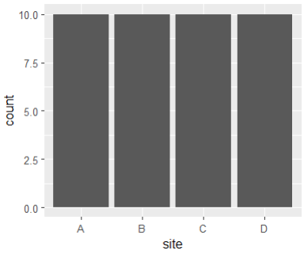
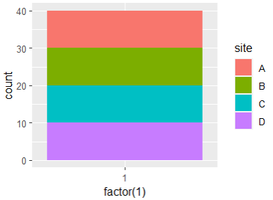
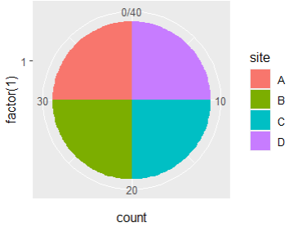
One variable – Categorical
Bar plot
Purpose: to see count of observations in each category
Example: how many datapoints at each <site>
Bar plot:
ggplot(data1, aes(x=site))+geom_bar()
Stacked bar plot:
data1$site=as.factor(data1$site) #good practice
ggplot(data1, aes(x=factor(1), fill=site)) +
geom_bar()
#bars side-by-side: geom_bar(position=position_dodge2())
Pie chart:
ggplot(data1, aes(x=factor(1), fill=site)) +
geom_bar() +
coord_polar("y")
This adds the different colours, known as “fill”, according to the values of <site>
Stacked bar plot
This creates a “dummy” variable to plot the bar
Pie chart
This makes it a pie chart

Slide 34
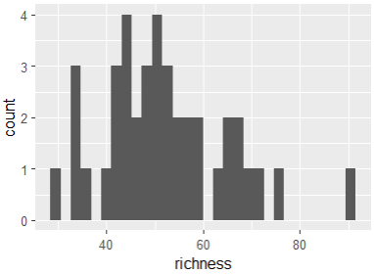
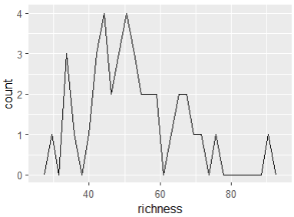
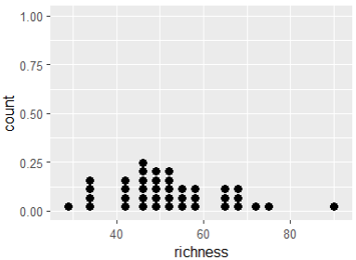
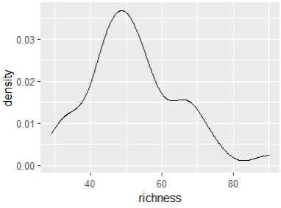
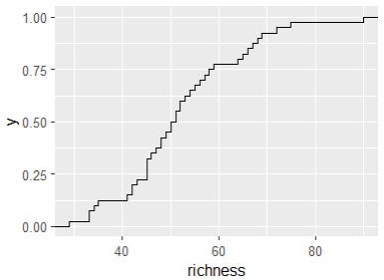
One variable – Continuous
Histogram
Frequency polygon
Purpose: to see how the values are distributed
Example: distribution of <richness>
Create the core plot:
b = ggplot(data1, aes(x=richness))
Histogram:
b + geom_histogram()
Frequency polygon:
b + geom_freqpoly()
Dotplot:
b + geom_dotplot()
Smoothened density estimate:
b + geom_density()
Cumulative density function:
b + stat_ecdf()
Dot plot
Smoothened density estimate
These four plots do pretty much the same thing. Which to use is a matter of personal preference but histograms are most common.
Cumulative density function
A single boxplot would also work but is less information (it doesn’t show you where the individual points are)

Slide 35
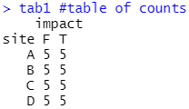
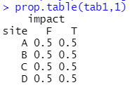
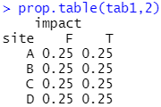
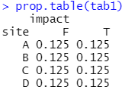
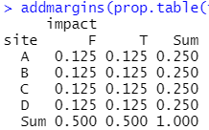
Two variables – Categorical (x) vs. Categorical (y)
Purpose: see how the observations are distributed across the various categories
Example: see if <site> affects <impact>
Contingency table of counts:
tab1=table(data1$site,data1$impact,dnn= c("site","impact"))
tab1 #table of counts
Contingency table of proportions:
prop.table(tab1,1) #rows sum to 1
prop.table(tab1,2) #columns sum to 1
prop.table(tab1) #all cells sum to 1
To add column and/or row totals to the tables:
addmargins(…,1) #replace the 3 dots with your table
#Note: 1 sums columns, 2 sums rows; opposite from prop.table()
addmargins(prop.table(tab1),c(1,2)) #sums both columns and rows
Contingency table of counts
Use the table() function in R. To draw pretty tables, or do it yourself in Word.
This argument adds the variable names to the table
Contingency tables of proportions
Answer

Slide 36
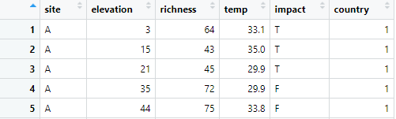
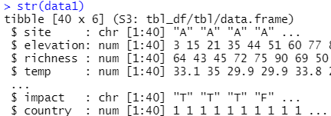
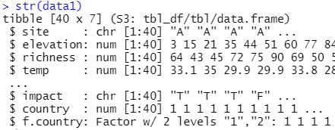
Two variables – Categorical (x) vs. Continuous (y)
Purpose: see how the values of y are distributed within each category of x
Example: see whether <country> can predict <richness>
Should <country> be a factor? Is it a factor?
data1$f.country=as.factor(data1$country)
#Creates another variable called <f.country> that is a factor
str(data1)
Before
After
New variable <f.country>

Slide 37
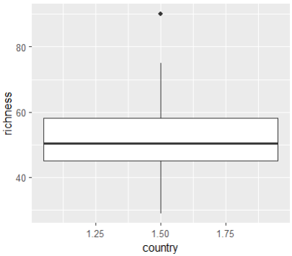
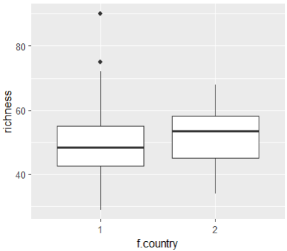
Two variables – Categorical (x) vs. Continuous (y)
Boxplots using both <country> and <f.country>:
ggplot(data1,aes(x=country,y=richness)) + geom_boxplot() #gives a warning
ggplot(data1,aes(x=f.country,y=richness)) + geom_boxplot()
<country>
<f.country>
This looks wrong, it doesn’t fulfil our purpose of seeing how <richness> is distributed in each category (aka level) of <country>: 1 and 2.
This is why it’s important to know what variable type your data are stored as in R, and to convert any grouping variables to factor type (especially if you used numbers as group categories).
This shows us that, in <country> 1: 1) Mean <richness> is lower 2) <richness> may have a wider range

Slide 38
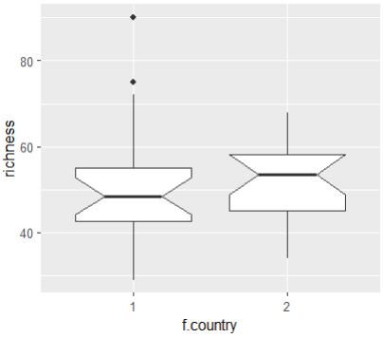
Two variables – Categorical (x) vs. Continuous (y)
Notched boxplot (helps to visualise significant differences between groups):
d=ggplot(data1,aes(x=f.country,y=richness))
d + geom_boxplot(notch=T)
Notched boxplot
The notches show the 95% confidence interval of the median (the thick line). If the notches of the two boxplots do not overlap, it is likely that they are significantly different from each other (still need to confirm it using a formal test).

Slide 39
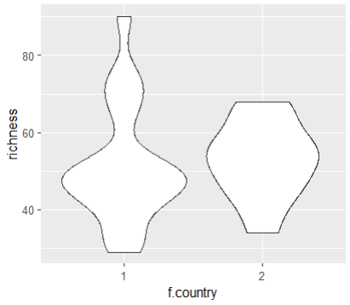
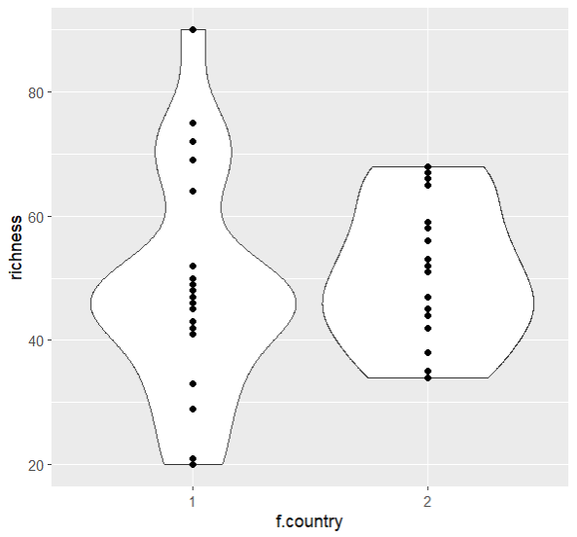
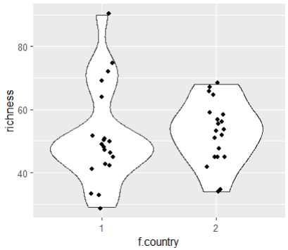
Two variables – Categorical (x) vs. Continuous (y)
Violin plot (helps to better visualise the distribution of datapoints):
d + geom_violin()
Violin plot with scatter of points:
d + geom_violin() + geom_point()
d + geom_violin() + geom_jitter(width=0.1)
You can plot another type of plot on top of the original plot
To improve the visibility of individual points. But be careful when using jitter: never jitter points when their position matters!
Violin plot
Violin plot with scatterplot on top
Previous … with a little jitter
There are more datapoints at these values where the violin plot is fatter

Slide 40
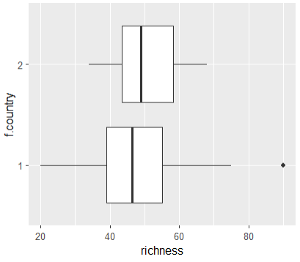
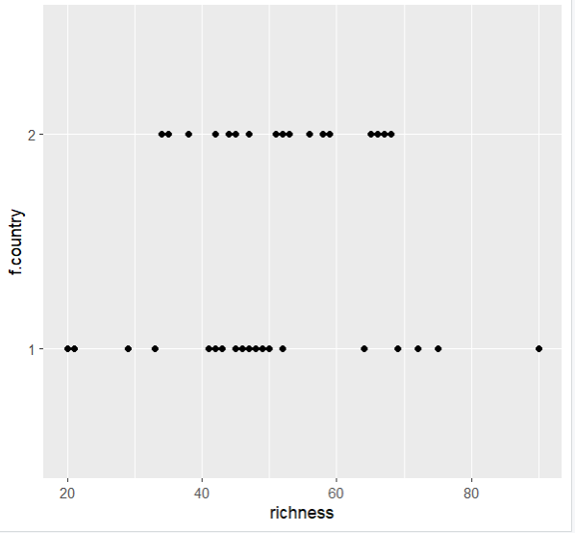
Two variables – Continuous (x) vs. Categorical (y)
Relatively rare, but can be plotted using horizontal boxplots or scatterplots:
d2=ggplot(data1,aes(x= richness,y=f.country))
d2+geom_boxplot()
Horizontal boxplot
Scatterplot
Same command as before. R automatically detects the variable types and plots horizontal boxplots

Slide 41
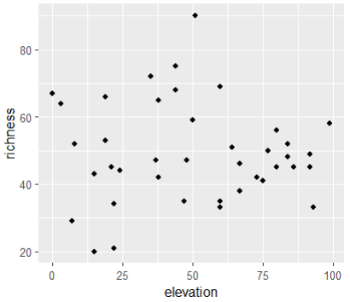
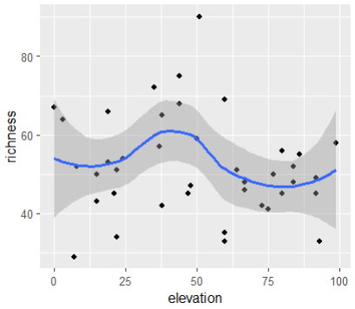
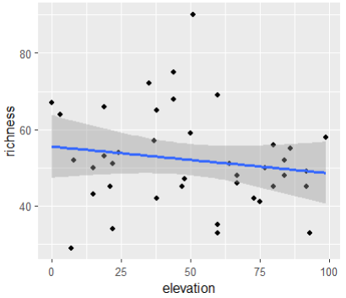
Two variables – Continuous (x) vs. Continuous (y)
Debugging Time!
Can you spot the error in this slide?
Purpose: see the relationship between two continuous variables
Example: see if <elevation> can be used to predict <richness>
Scatterplot:
f=ggplot(data1,aes(x=richness,y=elevation))
f + geom_point()
Scatterplot with a curve:
f + geom_point()+ geom_smooth()
Scatterplot with a linear trend line:
f + geom_point() + geom_smooth(method=lm)
Scatterplot with a linear line without standard error:
f + geom_point() + geom_smooth(method=lm,se=F)
Scatterplot
Scatterplot with a curve
Scatterplot with a linear trend line
Notes:
x should be elevation and y should be richness

Slide 42
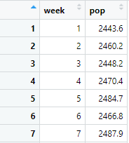


Two variables – Continuous (x) vs. Continuous (y)
Debugging Time!
Can you spot the error in this slide?
Purpose: see the progression from datapoint to datapoint
Example: see how a <pop> grows over <week>
Time series:
data3=read.csv("population.csv")
h=ggplot(data3,aes(x=Week,y=Pop))
h + geom_line()
h + geom_area() #shaded under the line
Step graph:
h + geom_step()
The x-variable is usually some measure of time
Time series
Time series (shaded)
Notes:
“Week” should be “week” and “Pop” should be “pop”

Slide 43


Three (or more) Variables
Looks complicated but it’s not!
- The type of figure (e.g. boxplot, scatterplot) is still decided by the two main (x and y) variables—what you just learnt.
- You then vary the colour/shape/size of the elements to represent the third variable.
In other words…
Variable 1: values on x-axis
Variable 2: values on y-axis
Variable 3: values represented by colour/shape/size of datapoints

Slide 44
Three (or more) Variables
How to decide? Go back to basics!
Step 1: What type are your 2 main variables: categorical or continuous?
Choose the type of figure to plot based on this (refer to the slides above)
Step 2: What type is your 3rd variable: categorical or continuous?
Choose between colour/shape/size based on this
Categorical | Colour and Shape are ideal. Size is possible but a little less effective.
Continuous | Size is ideal. Colour is also possible.

Slide 45


Three (or more) Variables – Continuous (x) vs. Continuous (y) + Categorical (colour or shape)
Answer
Since it’s continuous (x) vs. continuous (y): the main plot is a Scatterplot
<elevation> vs. <richness>:
f=ggplot(data1,aes(x=elevation,y=richness))
f + geom_point()
<elevation> vs. <richness> + <site>:
- Since <site> is categorical, we can use colour
f + geom_point(aes(col=site))
<elevation> vs. <richness> + <impact>:
- Since <impact> is categorical, we can use shape
f + geom_point(aes(shape=impact))
col=<site>
shape=<impact>
Just add this aes() argument to the geom_point() function
Tells R to change the colour of the points according to the values of <site>
Tells R to change the shape of the points according to the values of <impact>

Slide 46

Three (or more) Variables – Continuous (x) vs. Continuous (y) + Continuous (size)
<elevation> vs. <richness> + <temp>:
- <temp> is continuous: we could use size
f + geom_point(aes(size=temp))
size=<temp>

Slide 47

Three (or more) Variables – Continuous (x) vs. Continuous (y) + Continuous (colour)
<elevation> vs. <richness> + <temp>:
- We can also use colour for a continuous variable
f + geom_point(aes(col=temp),size=3)
Make the points bigger and easier to see, note that the size argument is OUTSIDE the aes() brackets.
col=<temp>
Can tell generally whether <temp> is low or high for each point but difficult to tell the approximate value, so its usefulness is limited. Look for patterns: e.g. are all the darker dots clustered toward one corner, etc.?

Slide 48

Three (or more) Variables – Continuous (x) vs. Continuous (y) + Everything!
<elevation> vs. <richness> + <site> + <impact> + <temp>:
f + geom_point(aes(col=site,shape=impact,size=temp))
What’s the difference between this “size” command and the “size” command in the previous slide?
Note: you can’t use them together, the overall size command will override this size command (i.e. you lose the information on <temp>)
col=<site>, shape=<impact>, and size=<temp>

Slide 49


Three (or more) Variables – Categorical (x) vs. Continuous (y) + Categorical (colour)
Answer
Since it’s categorical (x) vs. continuous (y): the main plot is a Boxplot
<site> vs. <richness>:
h=ggplot(data1,aes(x=site,y=richness))
h+geom_boxplot()
<site> vs. <richness> + <impact>:
- <impact> is categorical: we can use colour
h+geom_boxplot(aes(col=impact))
h+geom_boxplot(aes(fill=impact))
With boxplots, to add one more categorical variable, changing colour is best.
- But how to add another variable? Or how to add a continuous variable? We can’t change the shape/size of the boxplots. What can we do?
col=<impact>
fill=<impact>

Slide 50

Three (or more) Variables – Categorical (x) vs. Continuous (y) + Categorical (colour) + Categorical (shape)
We cleverly plot points over the boxplot (we learnt this just now with the violin plots) and change the shape/size of the points!
<site> vs. <richness> + <impact> + <country>:
data1$country=as.factor(data1$country) #make sure <country> is a factor first
h+geom_boxplot(aes(col=impact),outlier.shape=NA)+
geom_point(aes(col=impact,shape=country), position=position_dodge(width=0.5))
col=<impact>, shape of points=<country>
This suppresses any outliers from the geom_boxplot() so that they are not plotted twice when we use geom_point()
An added geom_point() tells R to plot points over the boxplots: - We need to use “col=impact” again so that the colour of the points match the boxplots - We then add “shape=country” as well
This “position” argument is to offset the points to the left and right of the centre so that they match their boxplots

Slide 51

Three (or more) Variables – Categorical (x) vs. Continuous (y) + Categorical (colour) + Continuous (size)
We can do this for both categorical and continuous variables
<site> vs. <richness> + <impact> + <temp>:
- <temp> is continuous: we can use size
h+geom_boxplot(aes(col=impact),outlier.shape=NA)+
geom_point(aes(col=impact,size=temp),position=position_dodge(width=0.5))
col=<impact>, size=<temp>
This is the only thing that is different from before

Slide 52

Three (or more) Variables – Categorical (x) vs. Continuous (y) + Categorical (colour) + Everything!
We can combine many variables at the same time!
<site> vs. <richness> + <impact> + <country> + <temp>:
h+geom_boxplot(aes(col=impact),outlier.shape=NA)+
geom_point(aes(col=impact,shape=country,size=temp),position=position_dodge(width=0.5))
But it becomes very difficult to interpret!
- You shouldn’t do it just because you can.
- It’s better to break the plot into separate plots.
col=<impact>, shape=<country>, and size=<temp>

Slide 53

Faceting to break up plots by variables
Draw <country>1 in one plot and <country>2 in another plot.
h+geom_boxplot(aes(col=impact),outlier.shape=NA)+
geom_point(aes(col=impact,size=temp),position=position_dodge(width=0.5))+
facet_grid(country~.)
More details on facet_grid() are given in the plotting aesthetics slides.
col=<impact>, size=<temp>
<country> has been removed from here
This facet_grid() argument has been added to break up the plot by <country>
<country>

Slide 54

Survival curves
Plot individuals remaining over the course of an experiment
Need to learn how to run a survival analysis first
- Will cover later in the semester

Slide 55
Summary (Learning Objectives)
Importance of data exploration
- The Golden Rule
- Loading datasets into R
3 steps in data exploration:
1) Understand your variables
- Variable types (R storage): num, int, chr, logi, Factor
2) Correct mistakes, Look for outliers, Look for the unexpected
3) Look for patterns (data visualisation)
- Variable types (data types): categorical, continuous
- One variables
- Two variables
- Three variables
- Survival curves
Plotting aesthetics

